Slide 1


Dongyue Li
09/14/2025

Slide 2

Outline
Executive Summary
Introduction
Methodology
Results
Conclusion
Appendix

Slide 3
Executive Summary
Summary of methodologies
Collecting, processing, cleaning, and visualizing Falcon 9 rockets and launch site data
Train predictive machine learning models to connect the rocket and launch site data with past launch outcomes
Predict the launching outcome based on the trained model and the input rocket and launch site data
Summary of all results
All four trained classifiers can predict the launching outcome with >80% accuracy
All four classifiers can identify which parameter has the most predictive power for the predictions
Along the process, dashboards and maps were created to better understand the data

Slide 4
Introduction
Project background and context
SpaceX advertises Falcon 9 rocket launches on its website with a cost of 62 million dollars, while other providers’ cost upward of 165 million dollars each.
Much of SpaceX’s savings is because SpaceX can reuse the first stage of rockets. If we can determine if the first stage will land, we can determine the cost of a launch
This information can be used if an alternate company wants to bid against SpaceX for a rocket launch.
Problems you want to find answers
Can we predict if the Falcon 9 rocket’s first stage will land successfully or not based on data of the rocket, orbit, launch site, and previous launch outcome using machine learning methods?

Slide 5

Section 1

Slide 6
Methodology
Executive Summary
Data collection methodology:
Collect data of past launches through the SpaceX API requests and web scraping of Wikipedia webpage
Perform data wrangling
Data selection: keep only the data fields useful for launch outcome prediction
Data cleaning: fill NaNs and remove samples irrelevant or contain erroneous values
Data formatting and encoding: convert data to format that facilitate model prediction
Perform exploratory data analysis (EDA) using visualization and SQL
Using SQL and Python to collect, visualize, and map data from different sources
Perform interactive visual analytics using Folium and Plotly Dash
Building dashboard to interactively visualize and explore the relationship among data fields
Perform predictive analysis using classification models
Build, tune, and evaluate 4 classification models to predict launching outcome

Slide 7
Data Collection
Describe how data sets were collected.
You need to present your data collection process use key phrases and flowcharts

Slide 8
Data Collection – SpaceX API
Collecting detailed rocket and launch data with SpaceX API
Using requests.get(url), status should be 200
Many data fields downloaded, kept only useful ones, including 'rocket', 'payloads', 'launchpad', 'cores', 'flight_number', 'date_utc’, etc.
Apply pre-defined functions to format the raw data from the API to more readable format in a Pandas dataframe
Filter the data frame and only keep Falcon 9 launches
Data wrangling of the dataframe to fill NaN data
https://github.com/dongyuegeo/ibm_data_science/blob/main/Capstone/Code/1-jupyter-labs-spacex-data-collection-api.ipynb
Install & import package, pre-define functions
Request raw SpaceX launch data with requests.get()
Extract useful fields and format into data frame
Filter out and keep Falcon 9 data, fill NaNs, export to CSV

Slide 9
Data Collection - Scraping
Falcon 9 historical launch records from a Wikipedia page scraping
Using BeautifulSoup to scrape a url response
Extract the data fields from the 3rd table on that page
Create a dataframe and parse the extracted table to fill the dataframe
https://github.com/dongyuegeo/ibm_data_science/blob/main/Capstone/Code/2-jupyter-labs-webscraping.ipynb
Install & import package, pre-define functions
Request historical Falcon 9 launch data from Wikipedia using request.get() and BeautifulSoup
Parse HTML table, extract table head from the table
Extract data from the HTML table and fill them in lists named from table head. Write lists into a data frame

Slide 10
Data Wrangling
Data processing
To create a clean dataset with only relevant fields to facilitate insight uncovering
Data field selection:
Focus only on Falcon 9 launches as of June 2021
Only keep the data about rockets and launches, which are useful for launch outcome prediction
Data wrangling and cleaning:
Explore data fields in dataframe to get familiar with the data, including data type, size, and missing values
Properly fill Null values
Data formatting and encoding:
Use pre-defined functions to extract to extract data from the messy raw table directly scraped from Internet
Process the data into format that facilitate the outcome prediction, e.g. encode the launch outcome to 0 and 1
https://github.com/dongyuegeo/ibm_data_science/blob/main/Capstone/Code/3-labs-jupyter-spacex-Data%20wrangling.ipynb

Slide 11
EDA with Data Visualization
Summarize what charts were plotted and why you used those charts
A series of plots were made to (1) understand the distribution and value of the data, and (2) explore the correlation among two variables. These exploratory analysis help familiarize with the data and facilitate data feature engineering.
Plots in this lab include:
Scatterplot of FlightNumber vs. PayloadMass
Scatterplot of FlightNumber vs LaunchSite
Scatterplot of PayloadMassa vs LaunchSite
Barplot of Success Rate by Orbit Type
Scatterplot of FlightNumber vs Orbit type
Scatterplot of PayloadMass vs Orbit type
Yearly trend of success rate
https://github.com/dongyuegeo/ibm_data_science/blob/main/Capstone/Code/5-eda%20data%20viz.ipynb

Slide 12
EDA with SQL
Using bullet point format, summarize the SQL queries you performed
Display the names of the unique launch sites in the space mission
Display 5 records where launch sites begin with the string 'CCA'
Display the total payload mass carried by boosters launched by NASA (CRS)
Display average payload mass carried by booster version F9 v1.1
List the date when the first succesful landing outcome in ground pad was acheived.
List the names of the boosters which have success in drone ship and have payload mass greater than 4000 but less than 6000
List the total number of successful and failure mission outcomes
List all the booster_versions that have carried the maximum payload mass, using a subquery with a suitable aggregate function.
List the records which will display the month names, failure landing_outcomes in drone ship ,booster versions, launch_site for the months in year 2015.
Rank the count of landing outcomes (such as Failure (drone ship) or Success (ground pad)) between the date 2010-06-04 and 2017-03-20, in descending order.
https://github.com/dongyuegeo/ibm_data_science/blob/main/Capstone/Code/4-jupyter-labs-eda-sql-coursera_sqllite.ipynb

Slide 13
Build an Interactive Map with Folium
Summarize what map objects such as markers, circles, lines, etc. you created and added to a folium map
The four launch sites were added as markers to the map
For each launch site, the launch outcomes were added as colored icon to show total number of launches and the number of successful/failed launches
At VAFB SLC-4E, circles were added to show number of launches and a line was added to show the distance between the launch site and a nearby rail way
Explain why you added those objects
The folium map allows to interactively visualize the location of each launch site and figure out how to find the optimal sites
https://github.com/dongyuegeo/ibm_data_science/blob/main/Capstone/Code/6-lab_jupyter_launch_site_location.ipynb

Slide 14
Build a Dashboard with Plotly Dash
The plots, graphs, and interactions added to the dashboard include:
A dropdown input allows to interactively select the success rate at which individual launch site or all sites to show
Pie charts showing the successful launch ratio at any individual site or all sites
A range slider to select the range of payload
A scatterplot showing the correlation between the selected payload and their launch outcome
Explain why you added those plots and interactions
These plots and interactions allows to perform interactive visual analytics on SpaceX launch data in real-time
https://github.com/dongyuegeo/ibm_data_science/blob/main/Capstone/Code/7-spacex-dash-app.py

Slide 15
Predictive Analysis (Classification)
Summarize how you built, evaluated, improved, and found the best performing classification model
Starting from loading necessary Python libraries
Download rocket and launch data, format the data and organize into feature data (X) and target vector (Y)
Perform train test split
For each classifier:
Define parameter set for grid search to choose from
Initiate the classifier
Define pipeline and grid search across all parameter combinations to choose the parameter combination with best accuracy
Test the trained classifier with the best performing parameters to predict the launching outcome using test data
Evaluate test data accuracy and generating confusion matrix
https://github.com/dongyuegeo/ibm_data_science/blob/main/Capstone/Code/8_SpaceX_Machine%20Learning%20Prediction_Part_5.ipynb
Install & import package, pre-define functions
Download data, identify training (X) and target (Y) data, split X, Y into training and test groups
Define parameters, initiate classifier, conduct grid search for best parameter combination
Evaluate accuracy using testing data, plot confusion matrix

Slide 16
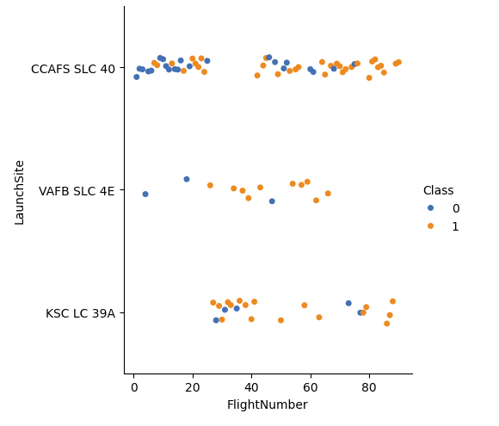
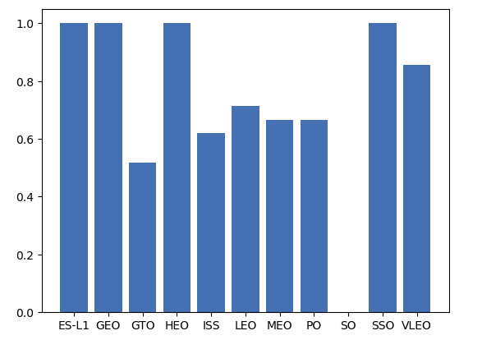
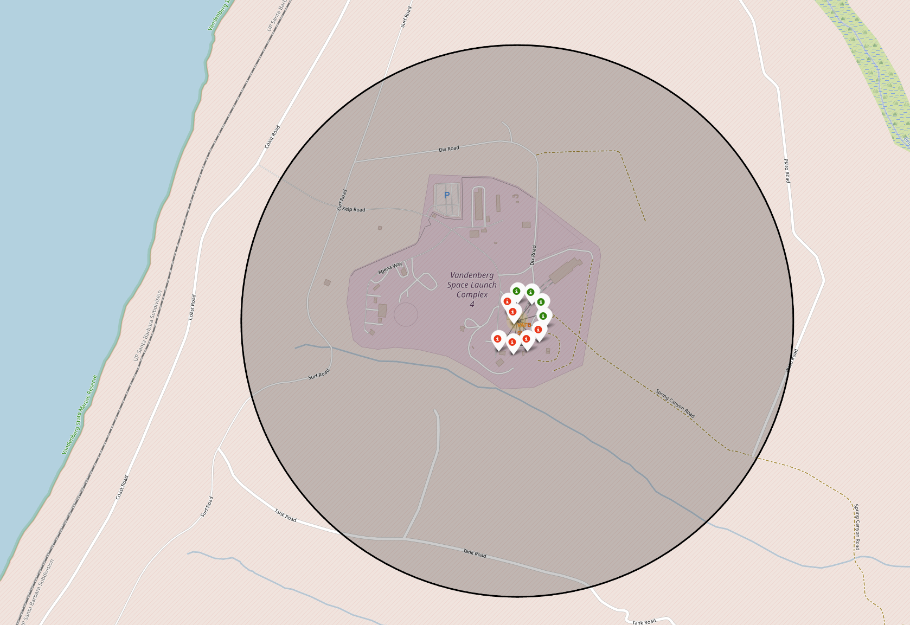
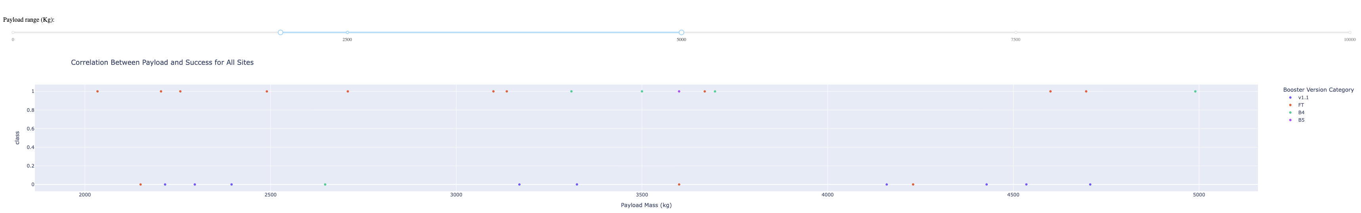
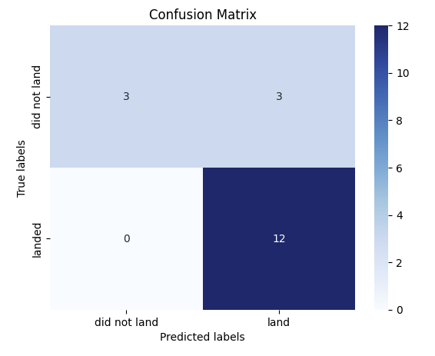
Results (more in the next session)
Exploratory data analysis results
Interactive analytics demo in screenshots
Predictive analysis results

Slide 17

Section 2

Slide 18
Flight Number vs. Launch Site
In all 3 sites, early launches have more unsuccessful cases. Successful launch rate increase as more launches are conducted at the site
CCAFS SLC 40 tends to be the primary site, as it has the most number of launches and the earliest launches
VAFB SLC4 4E has the most significant improvement in success rate

Slide 19
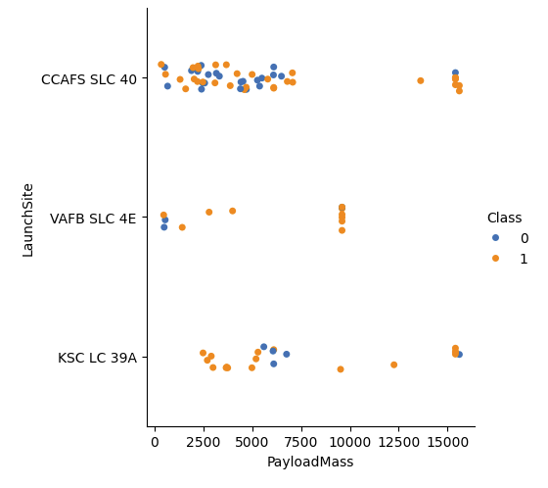
Payload vs. Launch Site
Heavy payloads (>10,000) are launched in CCAFS SLC 40 and KSC LC 39A
VAFB SLC 4E launches relatively small payloads
CCAFS SLC 40 has higher success rates than KSC LC 39A for launching heavy payloads

Slide 20
Success Rate vs. Orbit Type
Heavy payloads (>10,000) are launched in CCAFS SLC 40 and KSC LC 39A
VAFB SLC 4E launches relatively small payloads
CCAFS SLC 40 has higher success rates than KSC LC 39A for launching heavy payloads

Slide 21
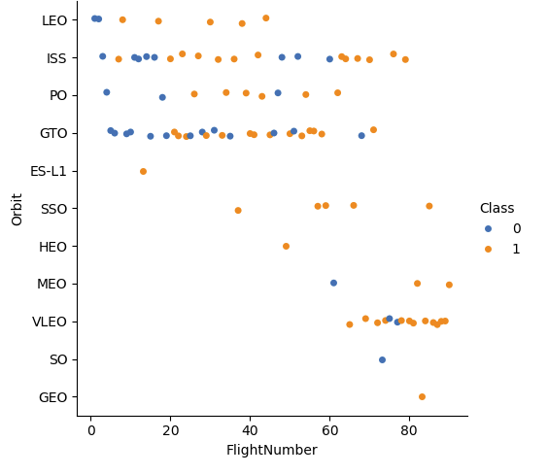
Flight Number vs. Orbit Type
Early launches (those with small flight numbers, <40) focus on near-surface orbit, as these orbits do not require large rockets and is comparatively easier than heavy rockets
Early flights has more failures (0). Success rate increases after 20 launches.

Slide 22
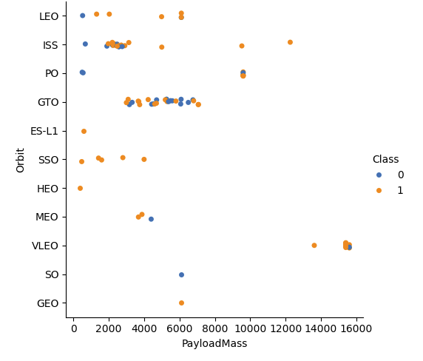
Payload vs. Orbit Type
Generally, small payloads are mounted at near-surface or low orbit satellite
Large payloads could be at mid-orbit or high-orbit

Slide 23
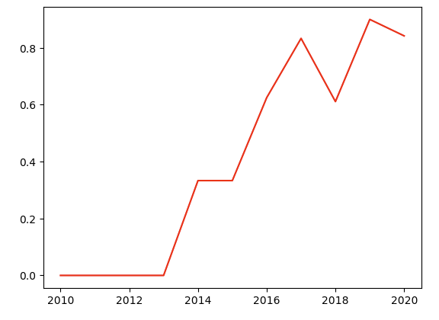
Launch Success Yearly Trend
Success rate is 0 ahead of 2013
Success rate kept increasing from 2013 to 2020

Slide 24
All Launch Site Names
Find the names of the unique launch sites
%sql select distinct "Launch_Site" from SPACEXTABLE
Present your query result with a short explanation here
There are 4 unique launch sites for Falcon 9, as below
Launch_Site
CCAFS LC-40
VAFB SLC-4E
KSC LC-39A
CCAFS SLC-40

Slide 25
Launch Site Names Begin with 'CCA'
Find 5 records where launch sites begin with `CCA`
%sql select * from SPACEXTABLE where "launch_site" like "CCA%" limit 5
Present your query result with a short explanation here
As attached below, the 5 records have names begin with ‘CCA’
Date | Time (UTC) | Booster_Version | Launch_Site | Payload | PAYLOAD_MASS__KG_ | Orbit | Customer | Mission_Outcome | Landing_Outcome
2010-06-04 | 18:45:00 | F9 v1.0 B0003 | CCAFS LC-40 | Dragon Spacecraft Qualification Unit | 0 | LEO | SpaceX | Success | Failure (parachute)
2010-12-08 | 15:43:00 | F9 v1.0 B0004 | CCAFS LC-40 | Dragon demo flight C1, two CubeSats, barrel of Brouere cheese | 0 | LEO (ISS) | NASA (COTS) NRO | Success | Failure (parachute)
2012-05-22 | 7:44:00 | F9 v1.0 B0005 | CCAFS LC-40 | Dragon demo flight C2 | 525 | LEO (ISS) | NASA (COTS) | Success | No attempt
2012-10-08 | 0:35:00 | F9 v1.0 B0006 | CCAFS LC-40 | SpaceX CRS-1 | 500 | LEO (ISS) | NASA (CRS) | Success | No attempt
2013-03-01 | 15:10:00 | F9 v1.0 B0007 | CCAFS LC-40 | SpaceX CRS-2 | 677 | LEO (ISS) | NASA (CRS) | Success | No attempt

Slide 26
Total Payload Mass
Calculate the total payload carried by boosters from NASA
%sql select sum("PAYLOAD_MASS__KG_") as total_mass from SPACEXTABLE where customer like "NASA%"
Present your query result with a short explanation here
Total payload carried by boosters from NASA is 99980 kg
total_mass
99980

Slide 27
Average Payload Mass by F9 v1.1
Calculate the average payload mass carried by booster version F9 v1.1
%sql select avg("PAYLOAD_MASS__KG_") as ave_mass from SPACEXTABLE where "Booster_Version" like "F9 v1.1%"
Present your query result with a short explanation here
average payload mass carried by booster version F9 v1.1 is 2535 kg
ave_mass
2534.6666666666665

Slide 28
First Successful Ground Landing Date
Find the dates of the first successful landing outcome on ground pad
%sql select min("Date") from SPACEXTABLE where "Landing_Outcome"="Success (ground pad)"
Present your query result with a short explanation here
first successful landing outcome on ground pad was on 2015-12-22
min("Date")
2015-12-22

Slide 29
Successful Drone Ship Landing with Payload between 4000 and 6000
List the names of boosters which have successfully landed on drone ship and had payload mass greater than 4000 but less than 6000
%sql select "Payload" from SPACEXTABLE where ("Landing_Outcome"="Success (drone ship)") AND ("PAYLOAD_MASS__KG_">4000 and "PAYLOAD_MASS__KG_"<6000)
Present your query result with a short explanation here
The following boosters have successfully landed on drone ship and had payload mass greater than 4000 but less than 6000
Payload
JCSAT-14
JCSAT-16
SES-10
SES-11 / EchoStar 105

Slide 30
Total Number of Successful and Failure Mission Outcomes
Calculate the total number of successful and failure mission outcomes
%sql select "Mission_Outcome", count(*) as count_out from SPACEXTABLE group by "Mission_Outcome"
Present your query result with a short explanation here
The total number of successful and failure mission outcomes is as below:
Mission_Outcome | count_out
Failure (in flight) | 1
Success | 98
Success | 1
Success (payload status unclear) | 1

Slide 31
Boosters Carried Maximum Payload
List the names of the booster which have carried the maximum payload mass
%sql select "Booster_Version", "PAYLOAD_MASS__KG_" from SPACEXTABLE where "PAYLOAD_MASS__KG_" = (select max("PAYLOAD_MASS__KG_") from SPACEXTABLE)
Present your query result with a short explanation here
Booster_Version | PAYLOAD_MASS__KG_
F9 B5 B1048.4 | 15600
F9 B5 B1049.4 | 15600
F9 B5 B1051.3 | 15600
F9 B5 B1056.4 | 15600
F9 B5 B1048.5 | 15600
F9 B5 B1051.4 | 15600
F9 B5 B1049.5 | 15600
F9 B5 B1060.2 | 15600
F9 B5 B1058.3 | 15600
F9 B5 B1051.6 | 15600
F9 B5 B1060.3 | 15600
F9 B5 B1049.7 | 15600

Slide 32
2015 Launch Records
List the failed landing_outcomes in drone ship, their booster versions, and launch site names for in year 2015
%sql select substr(Date, 6,2) as month, "Booster_Version", "Launch_Site" from SPACEXTABLE where (substr(Date,0,5)='2015') AND ("Landing_Outcome"="Failure (drone ship)")
Present your query result with a short explanation here
month | Booster_Version | Launch_Site
01 | F9 v1.1 B1012 | CCAFS LC-40
04 | F9 v1.1 B1015 | CCAFS LC-40

Slide 33
Rank Landing Outcomes Between 2010-06-04 and 2017-03-20
Rank the count of landing outcomes (such as Failure (drone ship) or Success (ground pad)) between the date 2010-06-04 and 2017-03-20, in descending order
%sql select "Landing_Outcome", count("Landing_Outcome") as count_out from SPACEXTABLE where ("Date">"2010-06-04" and "Date"<"2017-03-20") group by "Landing_Outcome" order by count_out desc
Present your query result with a short explanation here
Landing_Outcome | count_out
No attempt | 10
Success (drone ship) | 5
Failure (drone ship) | 5
Success (ground pad) | 3
Controlled (ocean) | 3
Uncontrolled (ocean) | 2
Precluded (drone ship) | 1
Failure (parachute) | 1

Slide 34

Section 3

Slide 35
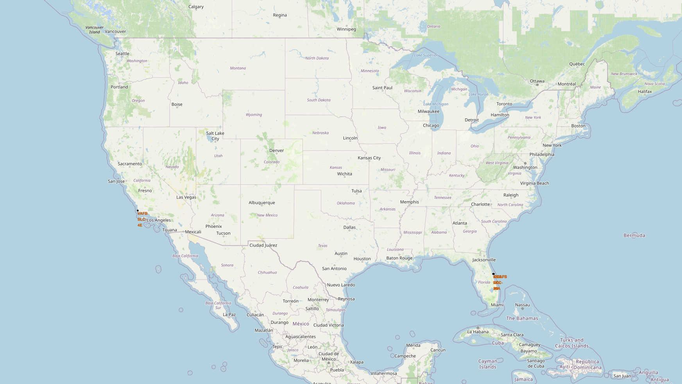
Location of Four Launching Sites
Screenshot (left) shows the location of four launching sites
Circle marks represent all launching sites are in low-latitude area in the U.S.
All sites are close to the ocean

Slide 36
VAFB SLC-4E Launching Record
The screenshot on the left shows the launching outcomes at this site
Big black circle shows the extent of the launch site, while marker cluster with colored icons represent past launches and outcomes
There were 10 total launches
Among the 10, 6 were successful (red) and 4 were failed (green)

Slide 37
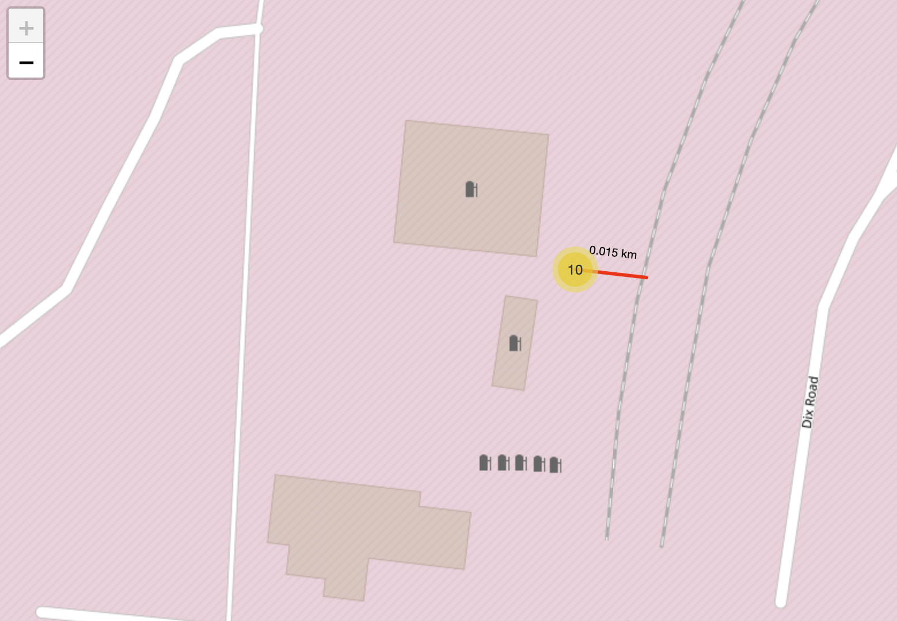
Distance between VAFB SLC-4E and Railway
Screenshot shows the launch pad and nearby railways
The shortest distance between the launch pad and the railway is about 0.015 km

Slide 38

Section 4

Slide 39
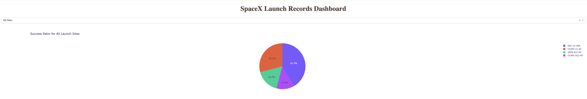
Pie chart for Success Launches by All Site
Screenshot of pie chart for all sites below show the successful launches at each site to the total number of successful launches
KSC LC-39A has the largest count of successful launches, while CCAFS SLC-40 has the least successful among the four sites

Slide 40
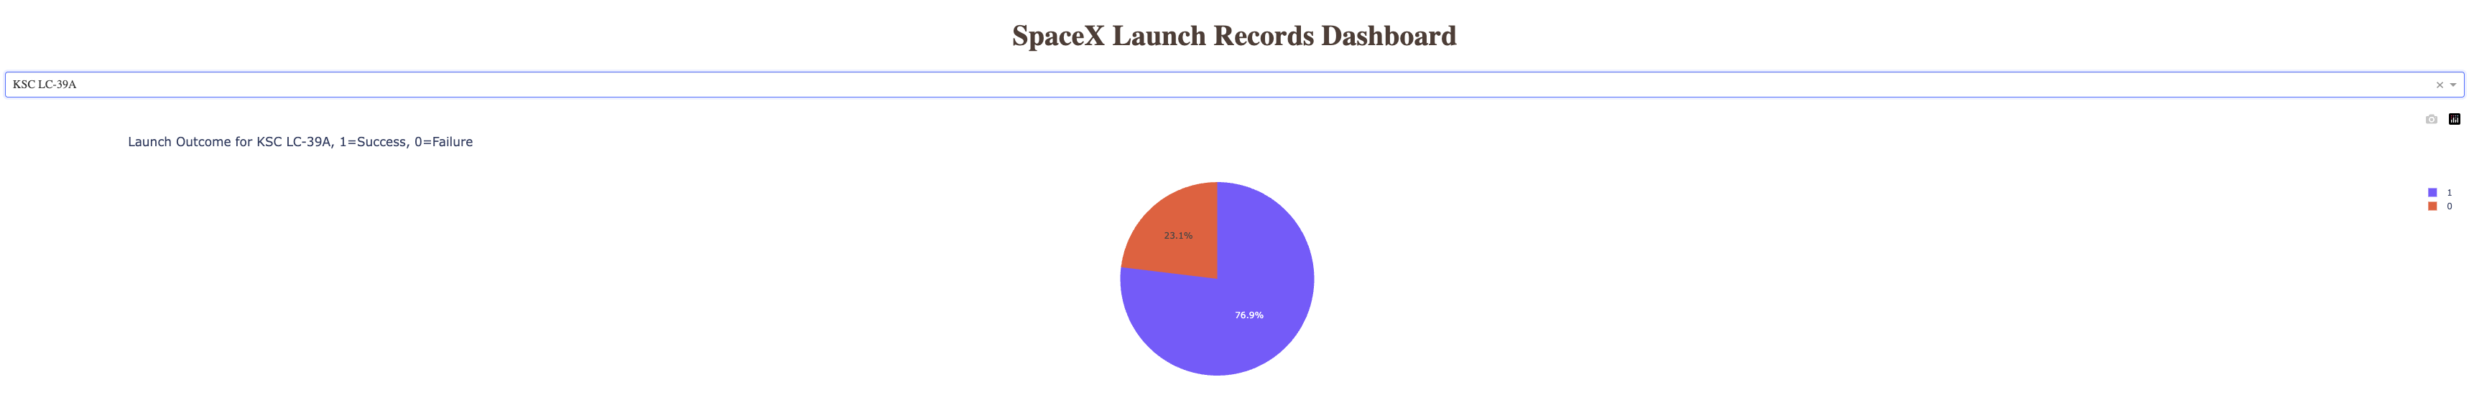
Launch Outcomes at Sites with Highest Success Ratio
Pie chart shows the success and unsuccess launch ratio at Site KSC LC-39A, which is the one with the highest success ratio; 73.1% success vs 26.9% fail

Slide 41
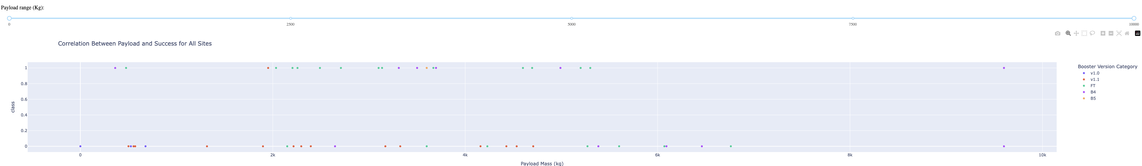
Payload vs. Launch Outcome Scatter Plot for All Sites
Screenshots show Payload vs. Launch Outcome scatter plot for all sites with different payload selected in the range slider
Payload range from 0 to 9600 Kg. Booster version FT has the largest amount of successful launches. There is no clear correlation between payload and outcome.

Slide 42

Section 5

Slide 43
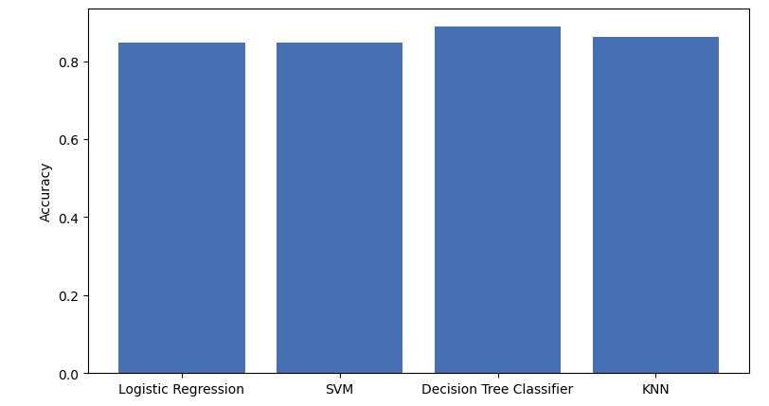
Classification Accuracy
Figure 1. Accuracy of the four classification methods
Conclusion: Decision Tree Classifier has the highest accuracy among the four methods

Slide 44
Confusion Matrix
Figure 1. confusion matrix of decision tree classifier
The classifier successfully forecasts 15 out of the 18 landing outcome, including 12 successful landing and 3 unsuccessful landing
The classifier has 3 false negative and 0 false positive forecasts

Slide 45
Conclusions
All four methods successfully predicted over 80% of the landing outcomes
Among the 4 prediction methods, decision tree classifier has the highest forecasting accuracy
Grid Search is able to find the best combination of parameters for each method
The more complex methods, i.e. those having more parameters or takes longer time to run, do not necessarily render more accurate predictions

Slide 46
Appendix
Include any relevant assets like Python code snippets, SQL queries, charts, Notebook outputs, or data sets that you may have created during this project

Slide 47


